Slide 1
Learner’s forum
100226
101292

Slide 2
background
As at Year 2012, literacy level among the student was at approximate 72%, which increased to 82%, as at year 2015.
With increasing number of learners, modern and efficient methods of learning need to be innovated and applied.
Utilizing the advancement in technology, we can create an enhancement in the education sector, to upgrade the mode of learning.

Slide 3
Problem statement
Inefficient modes of learning to reach an increasing number of students and learners.
Lack of organization of online resources and credited knowledge distribution among the education sector.
Changes in curriculum are implemented slowly and are cumbersome. Delays in obtaining written resources and materials.

Slide 4
objectives
To investigate the challenges that learners face while accessing learning materials.
To analyse the existing learning systems and identify its problems
To develop test and implement a platform that will ease the automation of the learning process.

Slide 5
methodology
Business Modelling
Data Modelling
Process Modelling
Application Generation
Testing and Turnover
The project was developed using the Rapid Application Development (RAD) Model.

Slide 6
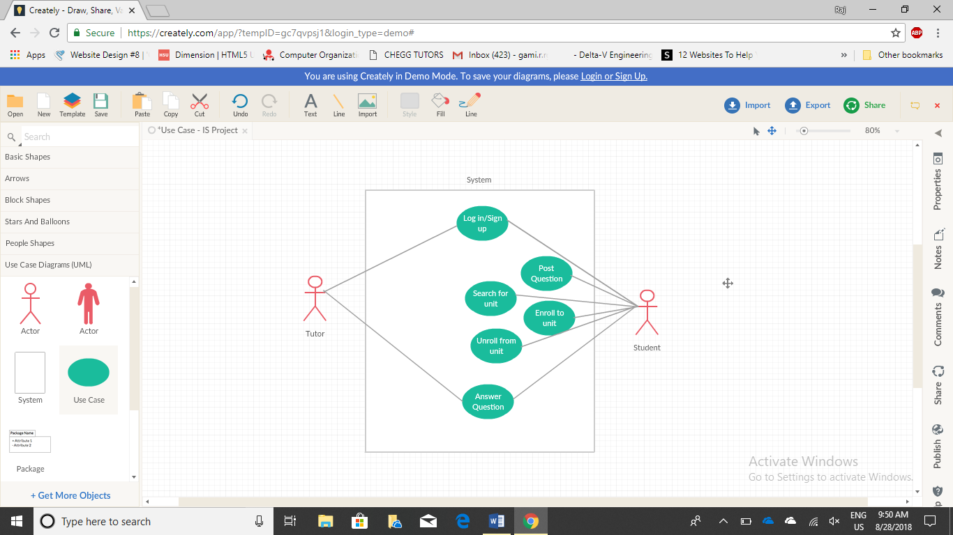
Use case diagram

